Slide 1
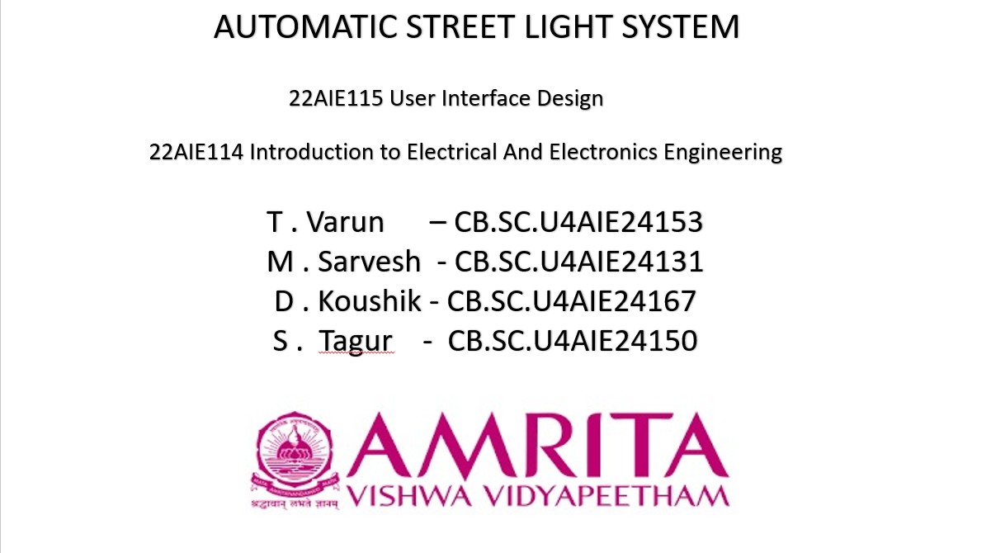

Slide 2
INTRODUCTION:
Smart Lighting System An Automatic Street Light System works on its own, turning lights on at night and off in the morning.
Light Detection Using Sensors It uses an LDR or other sensors to check light levels, detecting darkness to automatically switch lights on.
Energy Efficiency and Automation The system eliminates manual operation of street lights, reducing electricity wastage and improving efficiency.
Modern Urban Implementation These systems are widely used in smart cities, promoting sustainability and lowering power costs.

Slide 3
METHODOLOGY:
The LDR detects the surrounding light levels. It signals the microcontroller to turn the street lights on or off.
An infrared sensor detects the presence of vehicles on the road. If no vehicles are detected, the system reduces light intensity.
This technique helps in reducing electricity consumption. It can decrease power usage by up to 60%.
The microprocessor processes signals from sensors. It controls the LED activation based on real-time data.

Slide 4
Automatic operation eliminates the need for manual switching. It enhances convenience and ensures reliable lighting.
Smart lighting systems are widely used in modern cities. They promote sustainability and energy efficiency.
This system benefits both the environment and the economy. It provides cost savings while reducing carbon emissions.

Slide 5
COMPONENTS:
1.Light Dependent Resistor(LDR)
2.Power Supply
3.Connecting Wires
4.Arduino
5.Street Lights
6.IR-Sensors

Slide 6
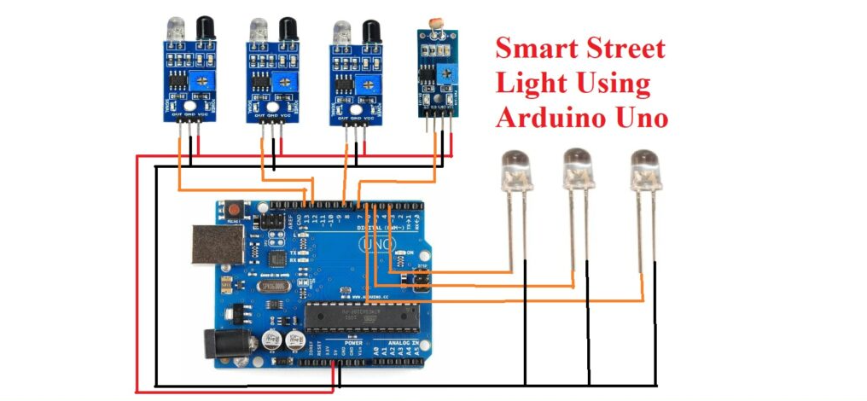
CIRCUIT DIAGRAM:

Slide 7
THANK YOU!

